Slide 1
Last measurements results for slow bump

Slide 2
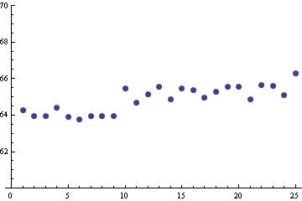
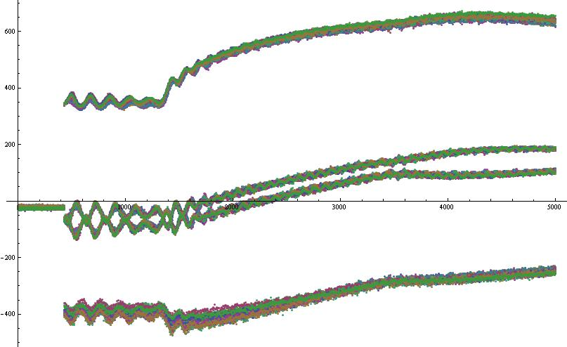
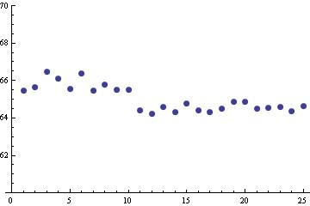
Orbit measurements during slow bump for core and islands.
Beam kicked in the islands at different time during the rise of the bump.
Different values of voltage for kfa71 : the bump is not closed.
Effects of the position of the MD1 cycle in the supercyle
Back to the previous sequence…

Slide 4
 | Q_{x} | Q’_{x} | Q’’_{x}
EAST_A | 0.2547 | -0.1007 | -48.727
LHCPROBE | 0.2549 | -0.0802 | -84.411
TOF | 0.2546 | -0.0673 | -65.061
SFTPRO | 0.2545 | -0.1123 | -84.641
EAST_A_last night | 0.25 | -0.9225 | -204.15
Non-linear chromaticity measurements
for various users.

