Slide 1
MTE latest measurements
A.Lachaize MTE meeting 07-07-11

Slide 2
Orbit measurements : The problem of orbit fluctuations is now solved, due to a better gate definition for the pickups.
Good stability of the kicker
We now want to measure the orbit with different settings than nominal one (resonance crossing from the opposite side, at 2GeV… )
Back to the slow bump closure study

Slide 3
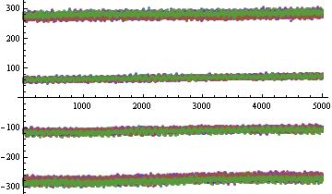
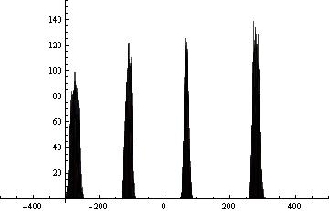
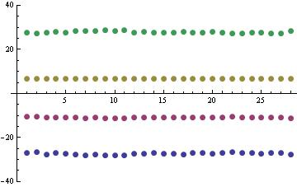
 | SLICE 1 | SLICE 2 | SLICE 3 | SLICE 4
Pickup 80 | S.deviation | S.deviation | S.deviation | S.deviation
25th may data | 0.628 | 0.403 | 0.368 | 0.604
23rd June 843ms | 0.759 | 0.576 | 0.489 | 0.623
Spread of the average position for each slice
Evolution of the average position for each slice, cycle after cycle
 | SLICE 1 | SLICE 2 | SLICE 3 | SLICE 4
Pickup 80 | Spread | Spread | Spread | Spread
25th may data | 1.587 | 0.648 | 0.536 | 1.211
23rd June 843ms | 1.685 | 0.933 | 0.272 | 1.470

Slide 4
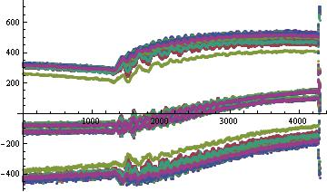
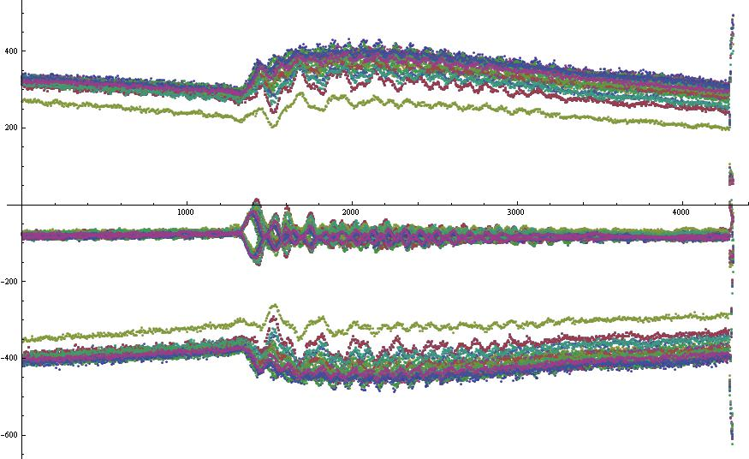
Slow bump closure
Slow bump at pickup 15
Slow bump at pickup 40
Clear non-closure during bump ramp

Slide 5
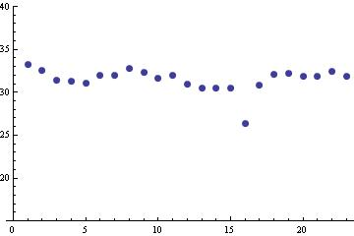
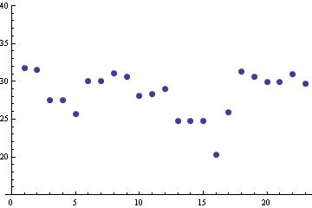
Average position of each cycle before bump
Average position of each cycle on the flat-top

Slide 6
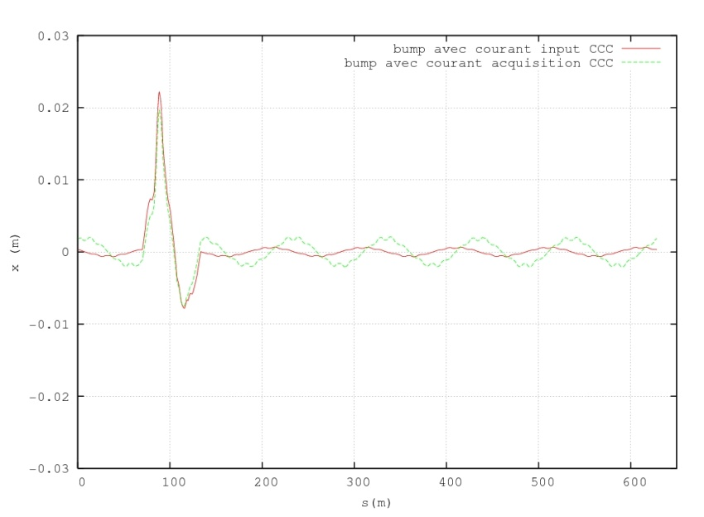
Detuning influence on the slow bump
Tune range from 6.25 to 6.26 induces a spread of 0.04mm

Slide 7
Next steps :
(re-) Calculation of 5-current matrix at 14GeV and 2GeV
New measurements for slow bump closure for core and islands by kicking the beam at different
Time.

