Slide 1
Analysis of recent PS measurements
MTE meeting 05/05

Slide 2
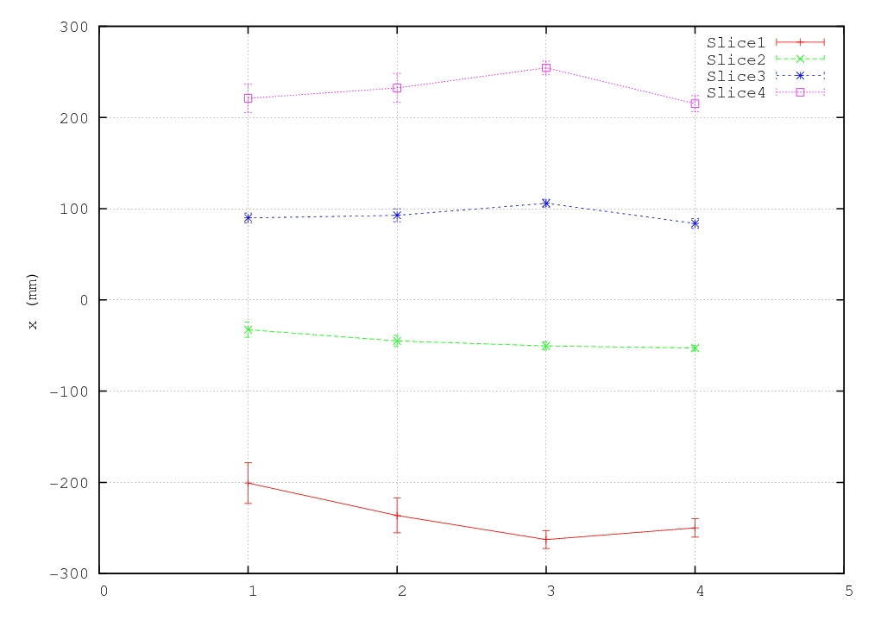
19th April : Sextupole variation
 | Sext 55 | Sext39
1 | 0 A | 180 A
2 | 60 A | 120 A
3 | 70 A | 130 A
4 | 180 A | 0 A
Q’_{H} = 0.566 Q’’_{H} = -530.98 Q’_{V} = 3.90 Q’’_{V} = 564.99 H₂₀₀=-23.2*10⁴ H₀₂₀₌31.9*10⁴ H₁₁₀=-26.5*10⁴
Q’_{H} = 0.549 Q’’_{H} = -530.8 Q’_{V} = 3.87 Q’’_{V} = 564.29 H₂₀₀=-22.5*10⁴ H₀₂₀₌33.09*10⁴ H₁₁₀=-27.72*10⁴
Q’_{H} = 0.228 Q’’_{H} = -539.3 Q’_{V} = 4.04 Q’’_{V} = 571.82 H₂₀₀=-28.8*10⁴ H₀₂₀₌28.16*10⁴ H₁₁₀=-21.3*10⁴
Q’_{H} = 0.517 Q’’_{H} = -532.33 Q’_{V} = 3.79 Q’’_{V} = 563.66 H₂₀₀=-24.8*10⁴ H₀₂₀₌33.64*10⁴ H₁₁₀=-28.21*10⁴
MTE meeting 05/05

Slide 3
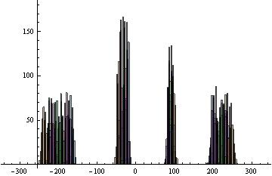
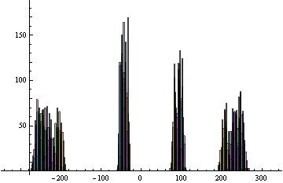
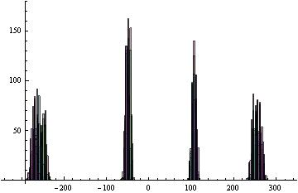
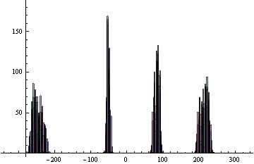
19th April : Sextupole variation
Sext55 0A Sext39 180A
Sext55 60A Sext39 120A
Sext55 70A Sext39 130A
Sext55 180A Sext39 0A

Slide 4
20 avril
 | SLICE 1 |  | SLICE 2 |  | SLICE 3 |  | SLICE 4
 | Average | S.deviation | Average | S.deviation | Average | S.deviation | Average | S.deviation
OMT 0 | -23.2443 | 2.6607 | -4.669 | 0.8991 | 8.9907 | 0.773 | 22.7811 | 2.021
Xmt39120A Xmt5560A | -23.4486 | 2.68183 | -4.451 | 0.9144 | 9.186 | 0.8003 | 23.1023 | 2.0302
Xmt39180A Xmt55 0A | -17.4941 | 2.8878 | -2.3782 | 1.011 | 8.531 | 0.661 | 20.44 | 2.04757
Xmt39 0A Xmt55180A | -25.161 | 1.1185 | -5.130 | 0.367 | 8.731 | 0.513 | 21.989 | 0.9042
Xmt39130A Xmt5570A | -26.075 | 1.002 | -4.7648 | 0.4165 | 10.8885 | 0.4433 | 25.696 | 1.311
18 avril “Nominal ”
 | SLICE 1 |  | SLICE 2 |  | SLICE 3 |  | SLICE 4
 | Average | S.deviation | Average | S.deviation | Average | S.deviation | Average | S.deviation
OMT Nominal | -17.03 | 3.82 | -2.583 | 2.08 | 7.61 | 1.774 | 18.75 | 2.843

Slide 5
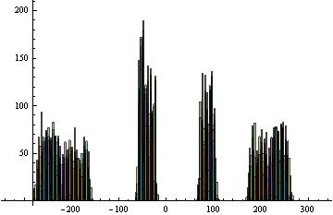
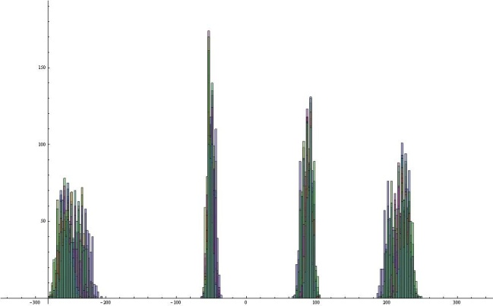
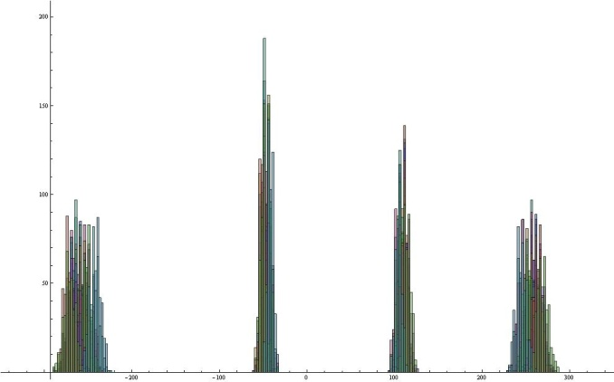
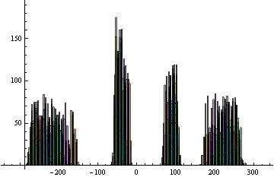
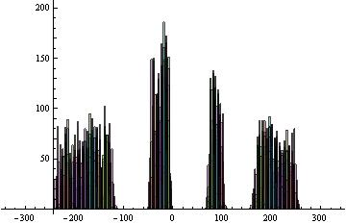
Xmt39 0A Xmt55 180A
OMT nominal
Xmt39 130A Xmt55 70A
Xmt39 120A Xmt55 60A
Xmt39 180A Xmt55 0A

Slide 6
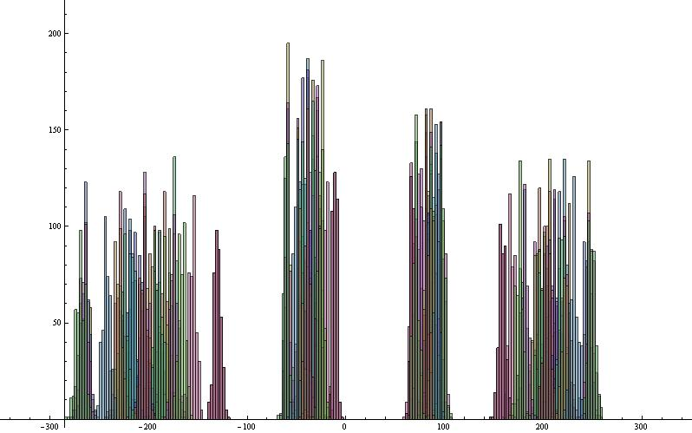
28th April | Average | S.deviation | Average | S.deviation | Average | S.deviation | Average | S.deviation
F8L | -204.47 | 36.4939 | -37.8602 | 13.22 | 83.55 | 9.011 | 206.18 | 24.72
12th May | Average | S.deviation | Average | S.deviation | Average | S.deviation | Average | S.deviation
F8L | -301.61 | 38.951 | -69.13 | 9.59 | 115.08 | 17.85 | 280.061 | 34.3383
28th April
12th April

Slide 7
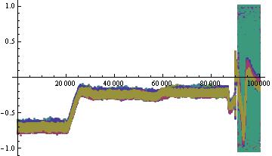
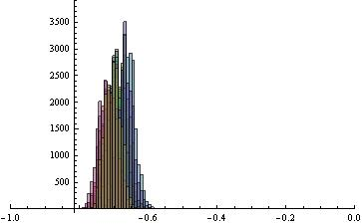
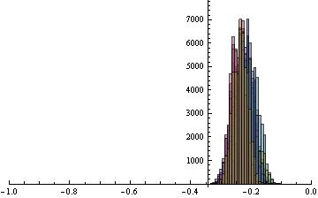
Pickup 83
No kick
 | Mean position | Standard Deviation
Pickup 83, no kicked beam | -1.947728 | 0.2351
1st April measurement, no island | 1.6 | 0.203

Slide 8
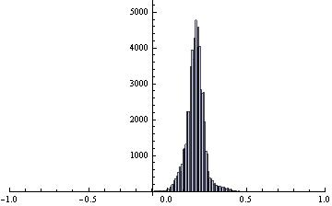
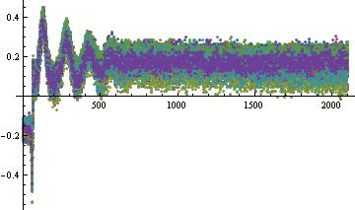
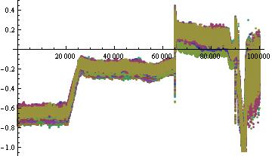
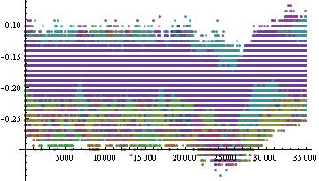
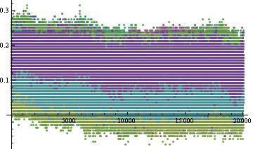
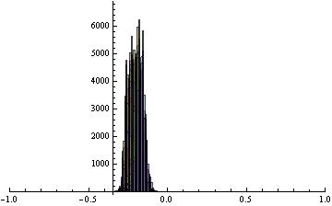
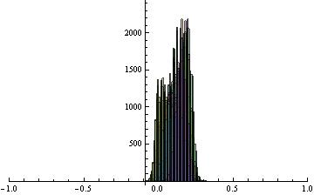
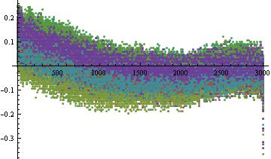
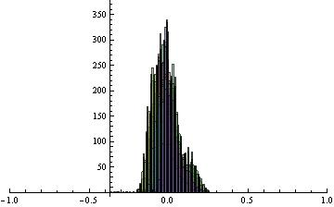
Pickup 83
kick
 | Mean | Standard Deviation
Before kick | -1.7242 | 0.2935
After kick | 1.5572 | 0.497
After decoherence | 1.0748 | 0.511
Rise of the bump | -0.1 | 0.471

Slide 9
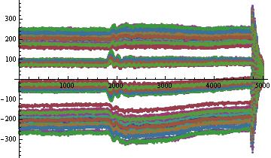
28th April | Average | S.deviation | Average | S.deviation | Average | S.deviation | Average | S.deviation
F8L | -20.45 | 3.65 | -3.78 | 1.32 | 8.355 | 0.901 | 20.618 | 2.472

Slide 10
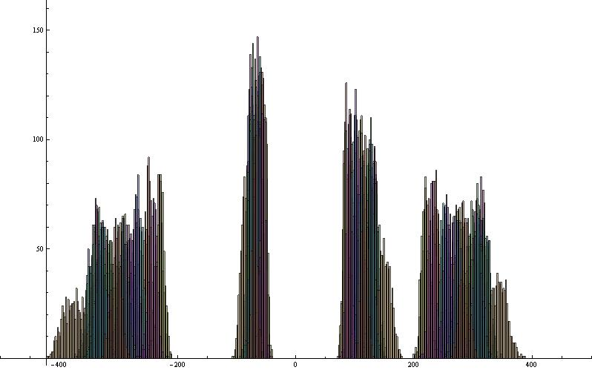
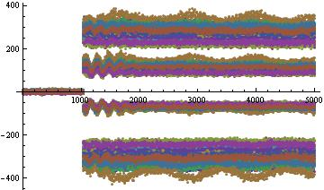
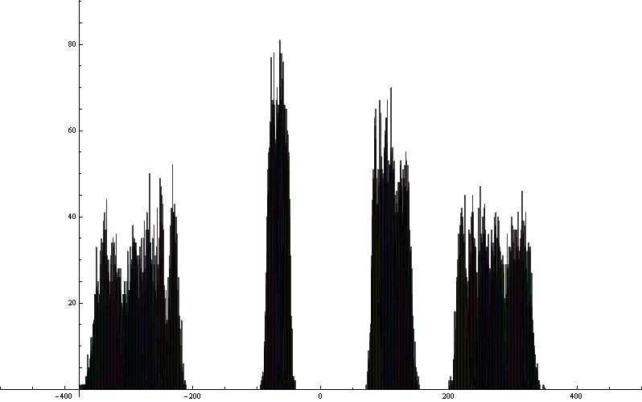
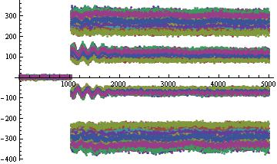
12th May | Average | S.deviation | Average | S.deviation | Average | S.deviation | Average | S.deviation
F8L | -30.104 | 3.8915 | -6.97 | 0.959 | 11.4121 | 1.78583 | 28.08 | 3.40596
12th May | Average | S.deviation | Average | S.deviation | Average | S.deviation | Average | S.deviation
F8L | -29.7489 | 3.64 | -6.89381 | 0.903 | 11.2384 | 1.6575 | 27.785 | 3.2253

Slide 11
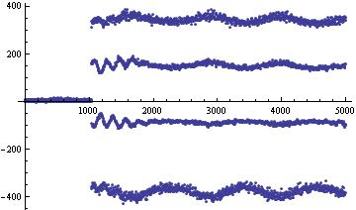
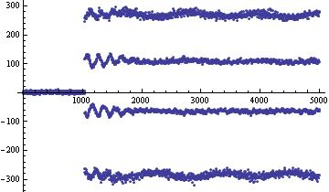
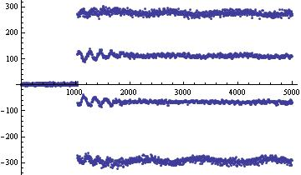
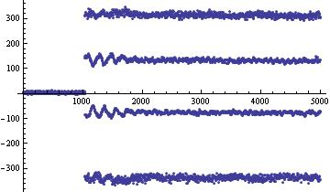
Shot 24
Shot 1
Shot 20
Shot 10

Slide 12
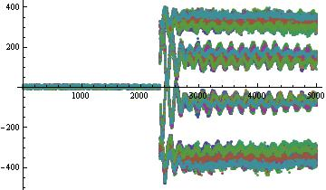
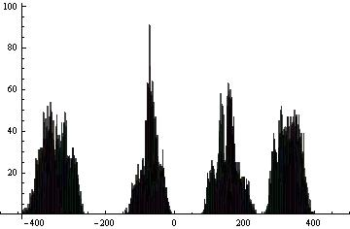
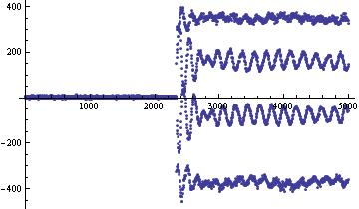
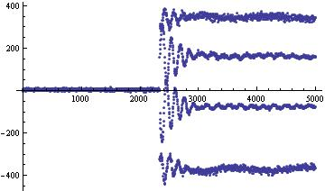
13th May X X’ | Average | S.deviation | Average | S.deviation | Average | S.deviation | Average | S.deviation
PFW 4 courants | -34.8335 | 3.0687 | -6.993 | 2.098 | 15.0063 | 2.500 | 33.0084 | 2.420

Slide 13
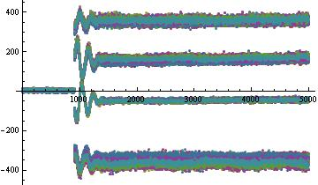
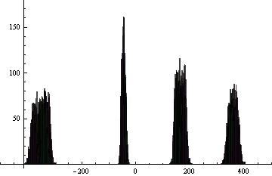
15th May | Average | S.deviation | Average | S.deviation | Average | S.deviation | Average | S.deviation
PFW 3 courants | -34.9294 | 2.003 | -4.567 | 0.533 | 16.0211 | 1.273 | 35.6234 | 1.247

Slide 14
