Slide 1
Displacement of γ-jump quadrupole in SS15
H. Bartosik
28.07.2011

Slide 2
Introduction
γ-jump in the PS is needed to avoid (microwave and TMCI) instability at transition crossing
Present layout
  4 doublets (change polarity for the jump) and 2 triplets
  Phase advance of π between γ-jump quadrupoles of same family
  Symmetry already distorted in present layout (see later)
Try to find possible new location of the γ-jump quadrupole QNT15
  Use SS15 for installation of collimator in order to reduce losses on septum 16 for MTE beam

Slide 3
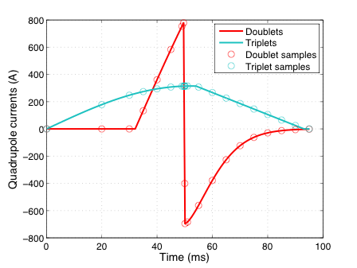
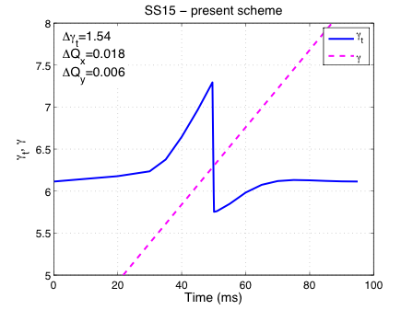
Simulation method
MADX simulation (without orbit errors for now)
Currents of γ-jump quadrupoles are sampled at key points of jump scheme
Optics and beam size around the ring are computed for each sample
Largest beam envelope throughout the jump at each location around the ring is stored
For each possible new quadrupole location, a simulation is performed

Slide 4
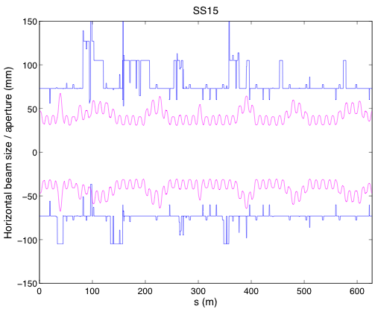

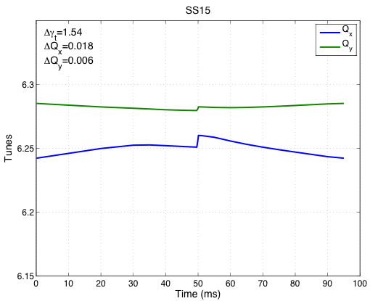
Present layout – SS15
Beam parameters used for the simulation
  Physical emittance at jump: ε_{x}=ε_{y}=4.03 μm*
  RMS momentum spread: δp=3.5e-3
Beam envelope is calculated as
  N_{σt}=3, N_{σl}=2*
  ε_{x} changed during gamma jump simulation according to 1/βγ
Present layout provides Δγ=1.54 with ΔQ<0.02
* As in S. Aumon, EPAC08

Slide 5
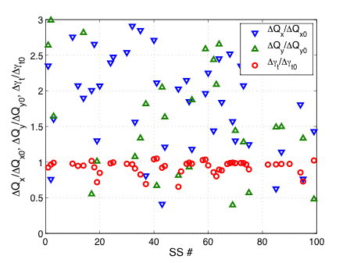
Possible new locations
In first iteration, consider only places where installation seems feasible without major modification of existing equipment
For now, polarity and strength of moving quadrupole is kept at standard values
Symmetic arrangement of jump quadrupoles was already modified in the past for placing equipment in certain locations in the PS
For each location with possible space for quadrupole, a simulation is made
Locations which may have space

Slide 6
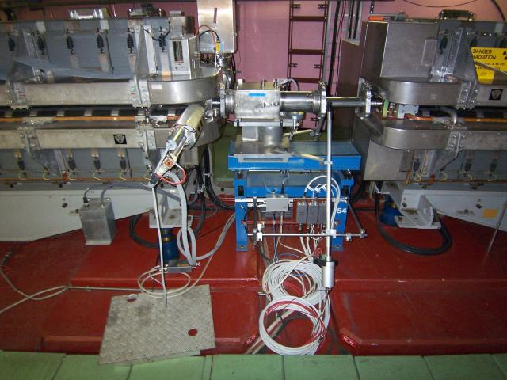
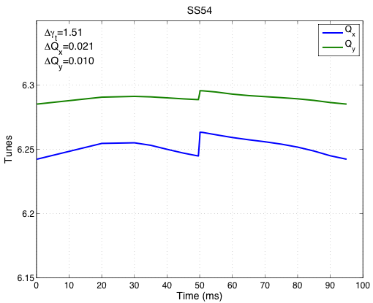
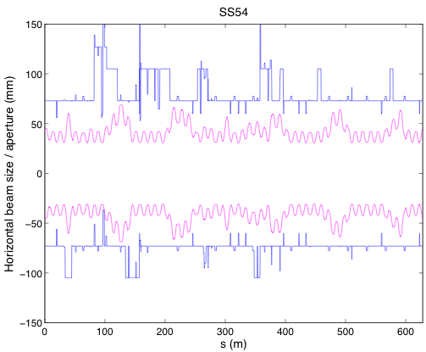
SS54
Existing equipment
  At the left, SEM grid
  On blue table, wire scanner
Installation of γ-quadrupole may be tight
Optical behavior
  comparable to present layout
  Δγ_{t}=1.51, ΔQ~0.02

Slide 7
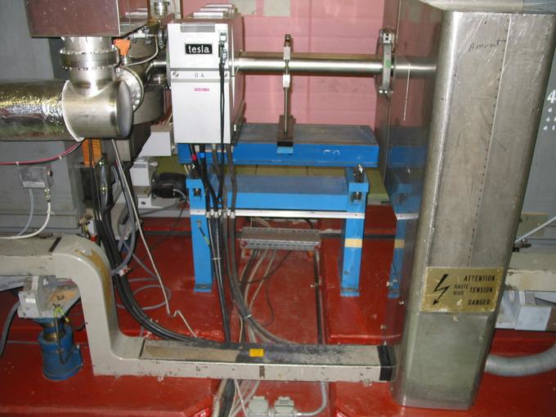
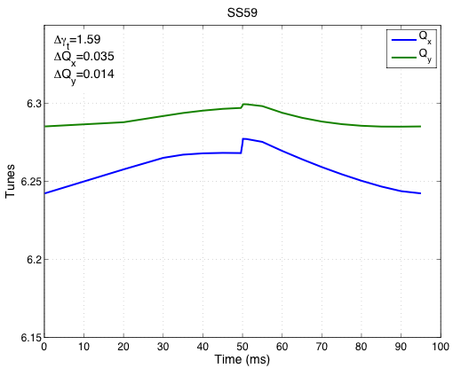
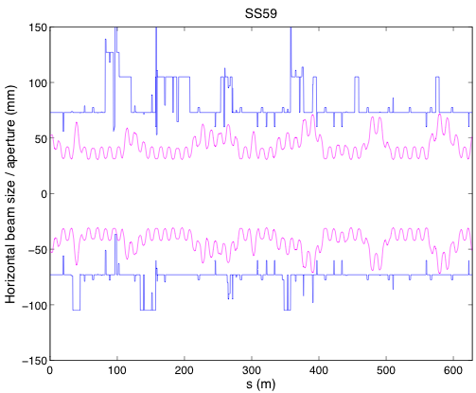
SS59
Existing equipment
  Horizontal dipole magnet serving to produce orbit bump in SS57
Enough space for γ-quadrupole
Optical behavior
  Δγ_{t}=1.59!, but ΔQ~0.035
  Aperture tighter …

Slide 8
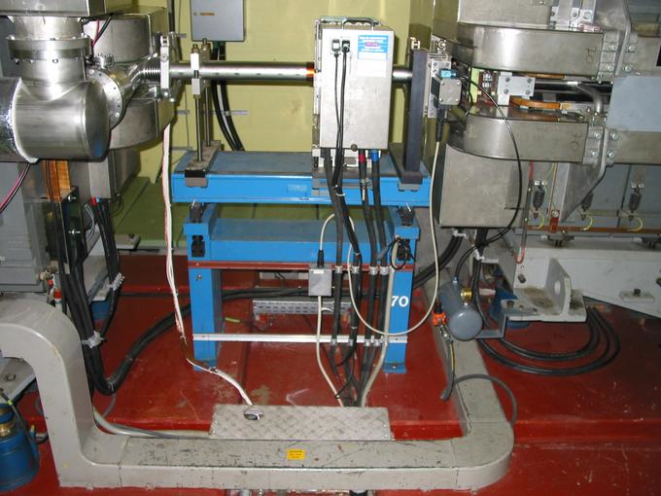
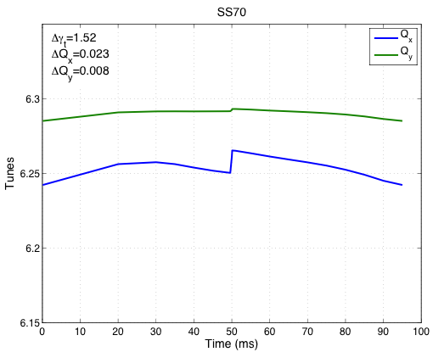
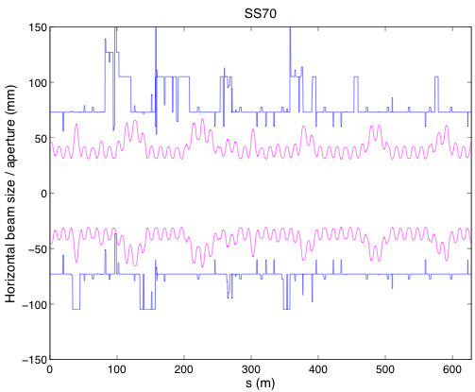
SS70
Existing equipment
  Octupole magnet
Enough space for γ-quadrupole
Optical behavior
  Similar to present layout
  Δγ_{t}=1.52, ΔQ~0.023
  Aperture a bight more relaxed

Slide 9
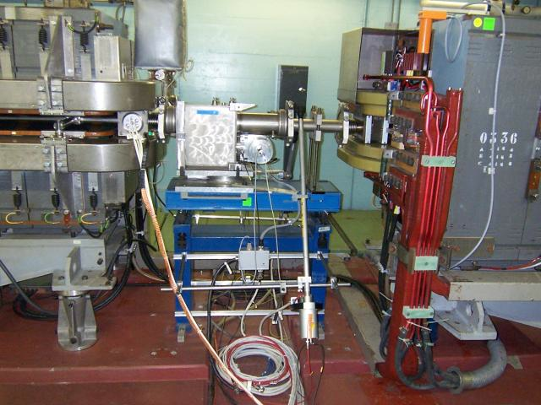
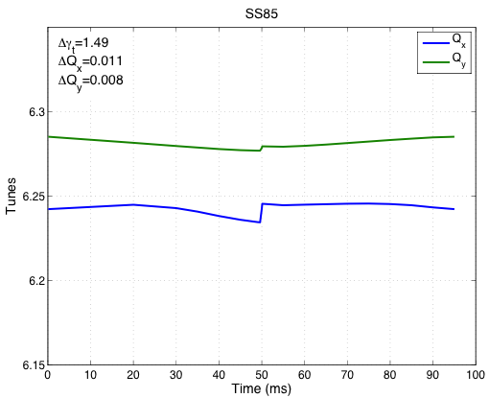
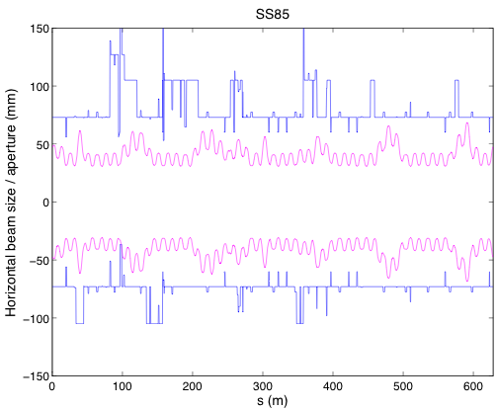
SS85
Existing equipment
  On blue table, wirescanner
Enough space for γ-quadrupole may be tight
Optical behavior
  4% smaller Δγ_{t} and smaller tune excursion
  Δγ_{t}=1.49, ΔQ~0.011
  Aperture a bit more relaxed? (e.g. SS63 …)

Slide 10
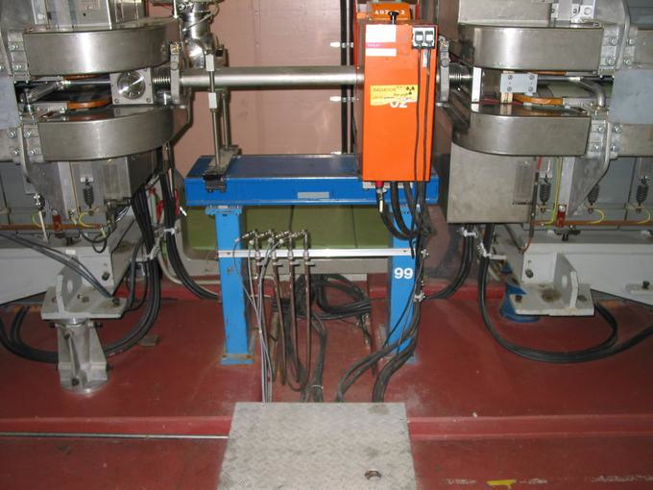
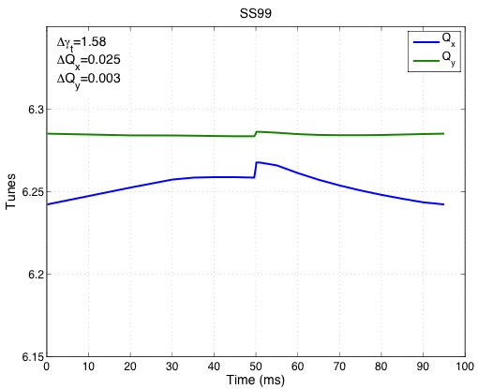
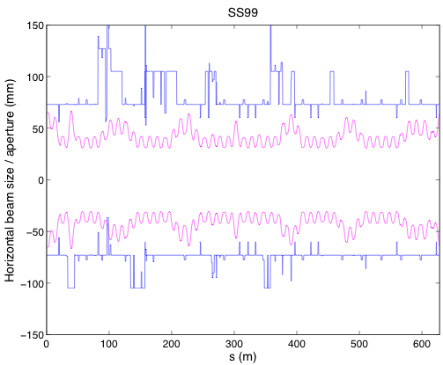
SS99
Existing equipment
  γ-quadrupole of same triplet family
Enough space for γ-quadrupole
Optical behavior
  Converting the triplet into a doublet …
  Δγ_{t}=1.58, ΔQ~0.025, aperture a bit tighter, especially in region of jump quadrupoles (99-7, as expected)
  Aperture or tune excursion may be optimized by individual power supplies

Slide 11
Summary
Relocation of γ-quadrupole from SS15 to another SS seems possible
Locations can be found, where similar optical behavior is expected
  Further studies should include orbit distortion (realistic simulation however may be difficult to achieve …)
  Inverted polarity has not been tried yet
  Possibility of individually powering the 4 families not used up to now → aperture or tune excursion may be optimized
On the expense of aperture and larger tune variation, the γ-jump reach can be even increased …
Depending on preference, locations can be found with larger available aperture but smaller Δγ_{t} and/or larger tune excursion

