Slide 1
MTE latest measurements
A.Lachaize MTE meeting 01/09/11

Slide 2
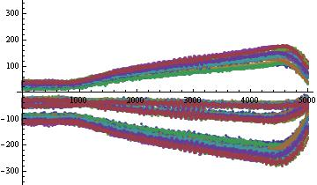
New measurements for “basic case ” (beam kicked in islands, no tune variations) in same conditions than last reference (July, 17th)
to compare with.

Slide 3
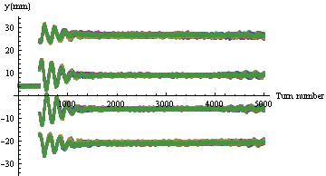
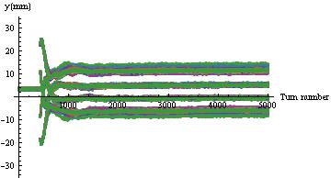
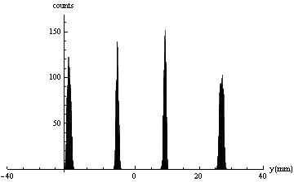
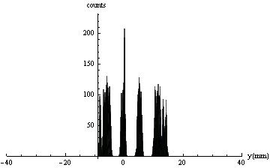
July,17th
September, 1st
 | SLICE 1 | SLICE 2 | SLICE 3 | SLICE 4
Pickup 80 | S.deviation | S.deviation | S.deviation | S.deviation
July,17th | 0.329 | 0.293 | 0.291 | 0.422
September,1st | 0.747 | 0.325 | 0.365 | 0.859

Slide 4
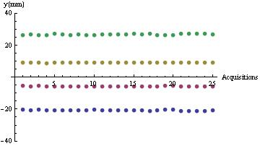
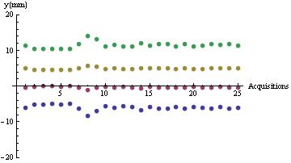
July,17th
September, 1st
 | SLICE 1 | SLICE 2 | SLICE 3 | SLICE 4
Pickup 80 | Spread | Spread | Spread | Spread
July,17th | 0.97 | 0.42 | 0.46 | 1.03
September,1st | 3.38 | 1.15 | 1.13 | 3.72

Slide 5
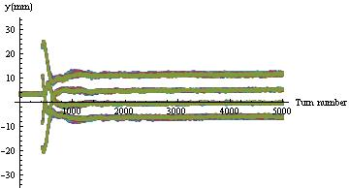
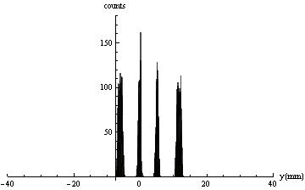
July,17th
September, 1st
 | SLICE 1 | SLICE 2 | SLICE 3 | SLICE 4
Pickup 80 | S.deviation | S.deviation | S.deviation | S.deviation
July,17th | 0.329 | 0.293 | 0.291 | 0.422
September,1st | 0.395 | 0.262 | 0.275 | 0.423

Slide 6
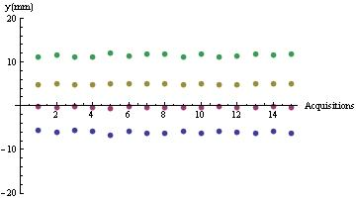
July,17th
September, 1st
 | SLICE 1 | SLICE 2 | SLICE 3 | SLICE 4
Pickup 80 | Spread | Spread | Spread | Spread
July,17th | 0.97 | 0.42 | 0.46 | 1.03
September,1st | 1.09 | 0.37 | 0.31 | 1.05

Slide 7
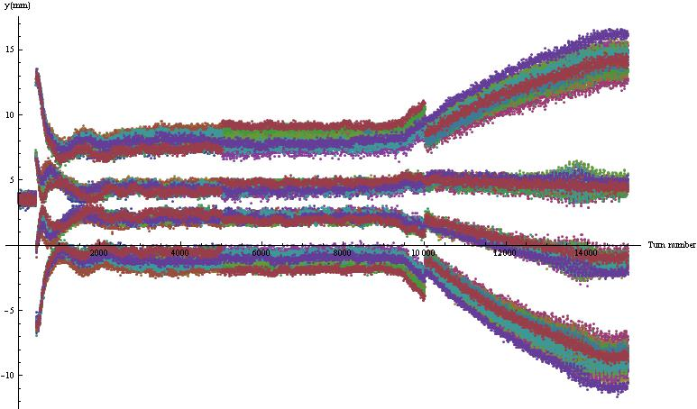
3 10ms acquisitions from the kick up to the top of the ramp.
Gap of 4 minutes between acquisitions with a least 4 SC changes….

Slide 8
SPARE LHCINDIV + CNGS instead of TOF
SPARE AD-EASTB

Slide 9
Next steps :
- Correlation between acquisitions during tune ramp and supercycle fluctuations.
- Comparison with measurements during dedicated MTE supercycle.
- Measurements with various PFW’s configurations.

