Slide 1
Analysis of recent PS measurements
MTE meeting 05/05

Slide 2
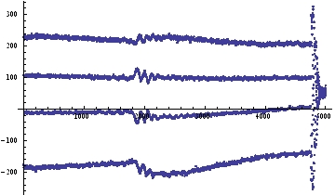
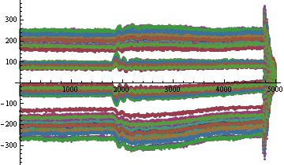
Study of the fluctuation of the slices trajectory.
In order to be able to measure each trajectory, islands are generated and the beam is kicked inside one.
MTE meeting 05/05

Slide 3
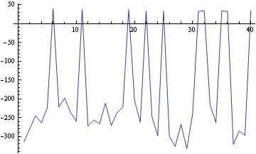
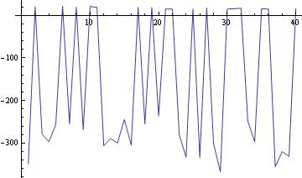
First attempt of analysis by average position calculation :
Evolution of the average position for the first slice during first
2000 turns of each shot of the 1st April at pickup 25
Evolution of the average position for the first slice during first
2000 turns of each shot of the 1st April at pickup 03
Analysis by histogram plot with average position and standard deviation calculation
MTE meeting 05/05

Slide 4
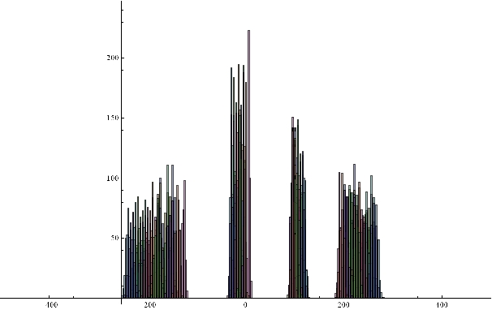
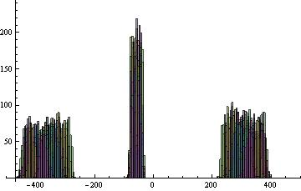
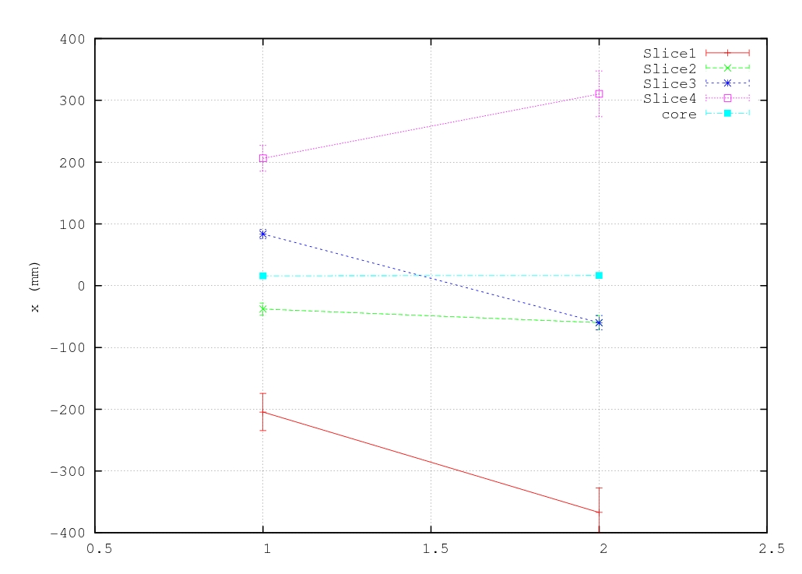
1st and 2nd April
2nd April, pickup 83
1st April, pickup 83

Slide 5
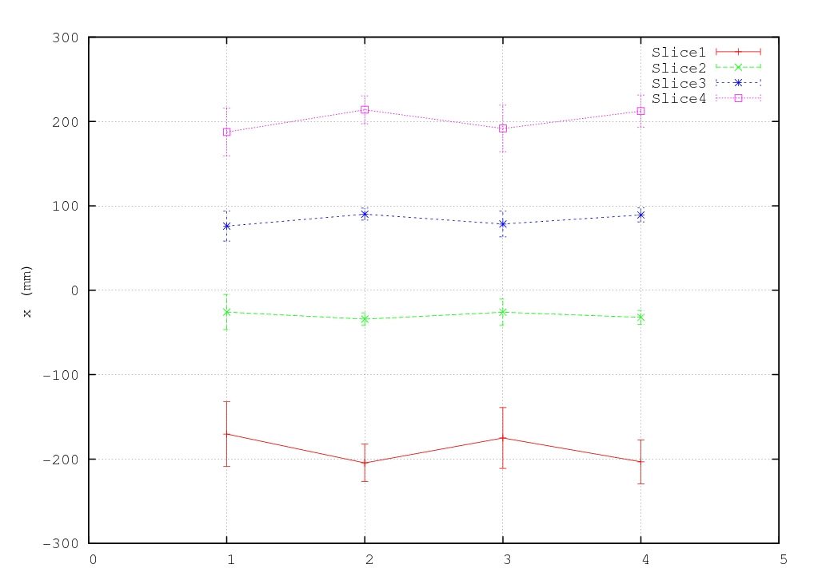
18th April : Octupole variation
 | Oct55 | Oct39
1 | 35 | -39
2 | 0 | -4A
3 | -4A | 0
4 | 45 | -49
Q’_{H} =0.71 Q’’_{H} = -527 Q’_{V} =3.78 Q’’_{V} = 560.77 H₂₀₀=-19.8*10⁴ H₀₂₀=35.5*10⁴ H₂₀₀=-30.7*10⁴
Q’_{H} = 0.71 Q’’_{H} = -528.4 Q’_{V} =3.78 Q’’_{V} = 556.68 H₂₀₀=-19.8*10⁴ H₀₂₀=35*10⁴ H₂₀₀=-30.45*10⁴
Q’_{H} = 0.71 Q’’_{H} = -528.62 Q’_{V} = 3.78 Q’’_{V} = 556.26 H₂₀₀=-19.8*10⁴ H₀₂₀=35*10⁴ H₂₀₀=-30.41*10⁴
4 Q’_{H} = 0.71 Q’’_{H} = -526.54 Q’_{V} =3.78 Q’’_{V} = 561.95 H₂₀₀=-19.82*10⁴ H₀₂₀=35.5*10⁴ H₂₀₀=-30.8*10⁴
MTE meeting 05/05

Slide 6
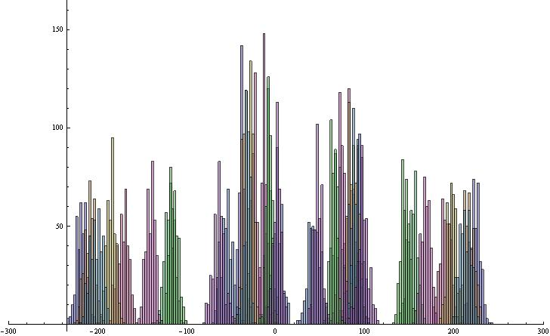
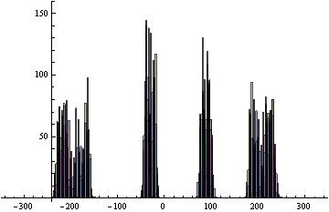
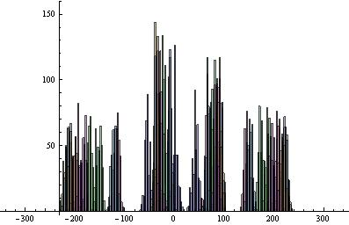
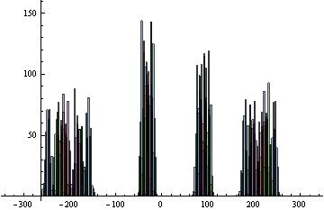
18th April : Octupole variation
Oct55 35A Oct39 -39A
Oct55 0A Oct39 -4A
Oct55 -4A Oct39 0A
Oct55 45A Oct39 -49A

Slide 7
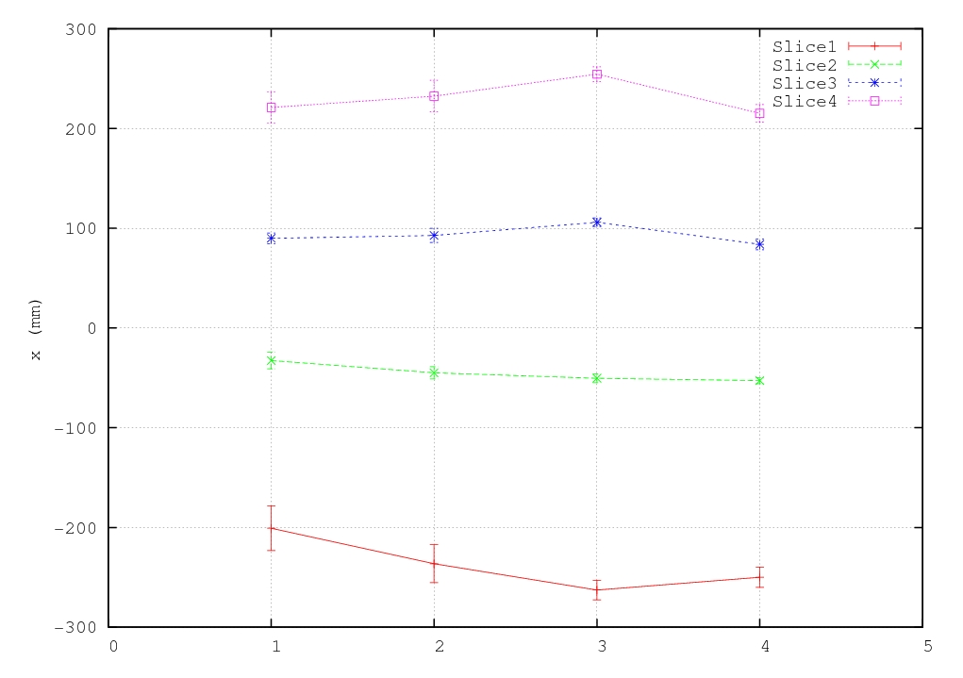
19th April : Sextupole variation
 | Sext 55 | Sext39
1 | 0 A | 180 A
2 | 60 A | 120 A
3 | 70 A | 130 A
4 | 180 A | 0 A
Q’_{H} = 0.566 Q’’_{H} = -530.98 Q’_{V} = 3.90 Q’’_{V} = 564.99 H₂₀₀=-23.2*10⁴ H₀₂₀₌31.9*10⁴ H₁₁₀=-26.5*10⁴
Q’_{H} = 0.549 Q’’_{H} = -530.8 Q’_{V} = 3.87 Q’’_{V} = 564.29 H₂₀₀=-22.5*10⁴ H₀₂₀₌33.09*10⁴ H₁₁₀=-27.72*10⁴
Q’_{H} = 0.228 Q’’_{H} = -539.3 Q’_{V} = 4.04 Q’’_{V} = 571.82 H₂₀₀=-28.8*10⁴ H₀₂₀₌28.16*10⁴ H₁₁₀=-21.3*10⁴
Q’_{H} = 0.517 Q’’_{H} = -532.33 Q’_{V} = 3.79 Q’’_{V} = 563.66 H₂₀₀=-24.8*10⁴ H₀₂₀₌33.64*10⁴ H₁₁₀=-28.21*10⁴
MTE meeting 05/05

Slide 8
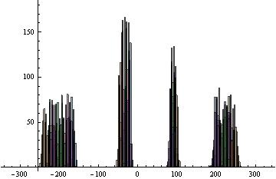
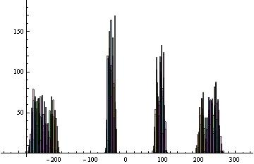
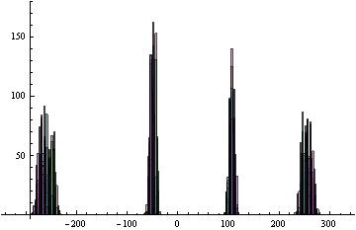
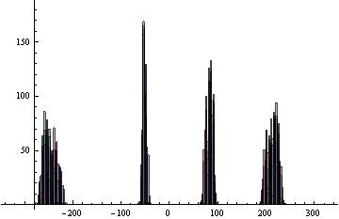
19th April : Sextupole variation
Sext55 0A Sext39 180A
Sext55 60A Sext39 120A
Sext55 70A Sext39 130A
Sext55 180A Sext39 0A

