Slide 1
Trajectory fluctuations in SPS : latest results.

Slide 2
Trajectory analysis completely restarted using a new code based on Andrea’s modules.
Automatic lecture of SPS Yasp files.
Pre-processing :
- Lecture of all BPM (~100). Taken into account if status ok and value
different than 0.
- Creation of corresponding ptc observation points file for comparison
between sps trajectory and tracking results.
- Lecture of correctors strength and creation of corresponding strength
file.
DFA’s kick taken into account.
100000 initial conditions tracked with ptc to fit the sps data.

Slide 3
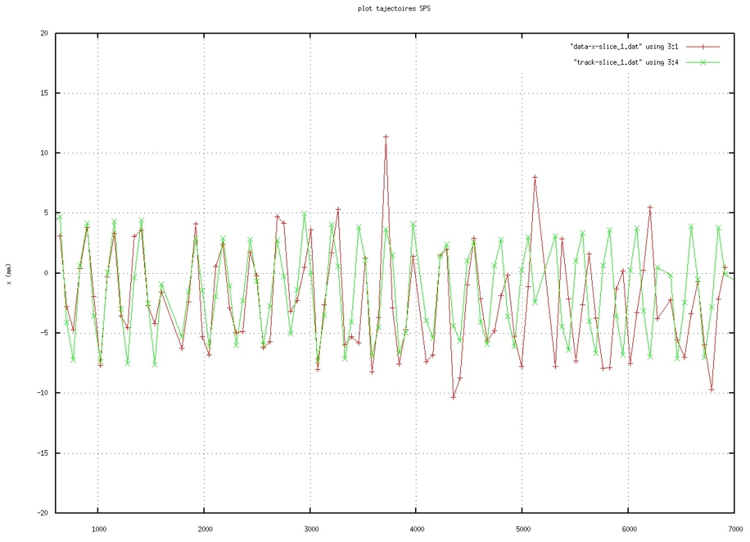
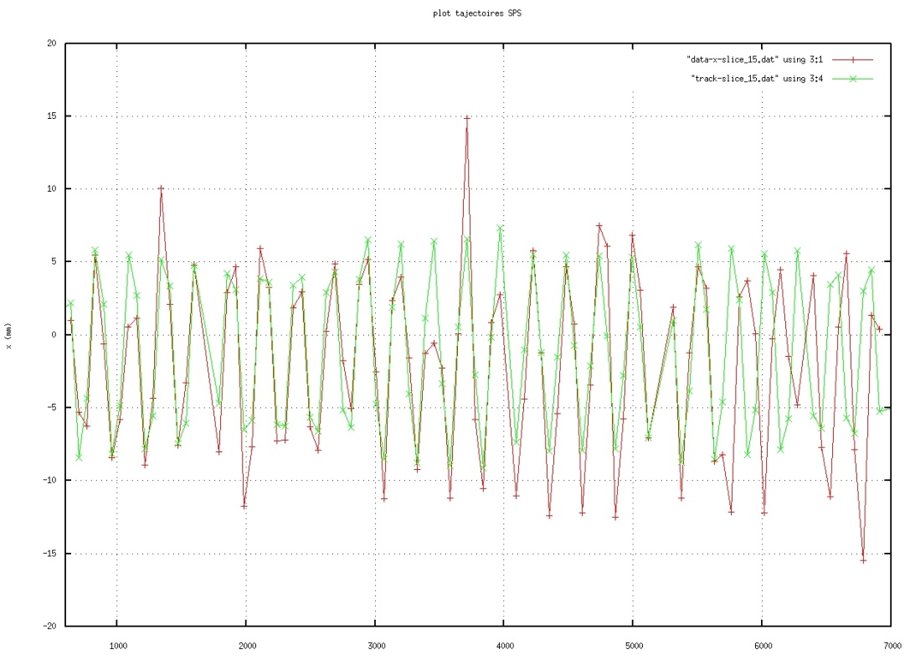
First tracking results :
First and second slices : good agreement

Slide 4
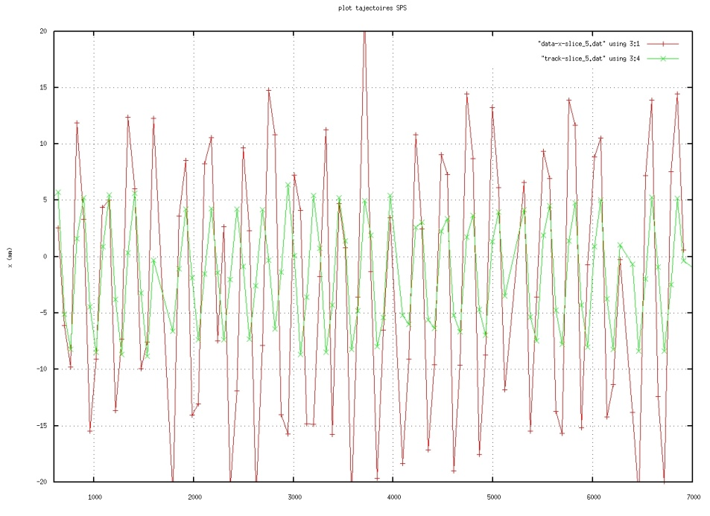
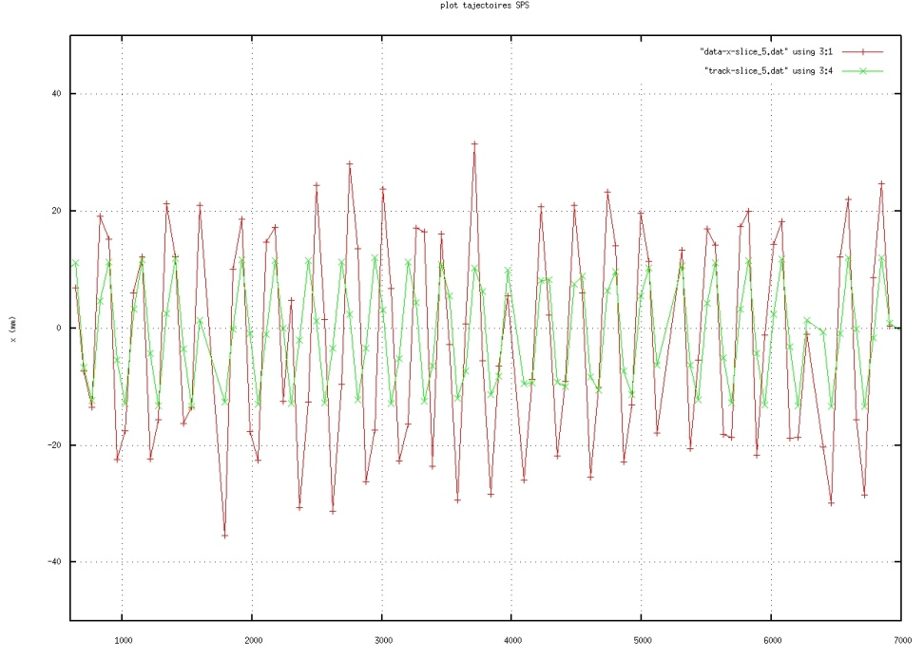
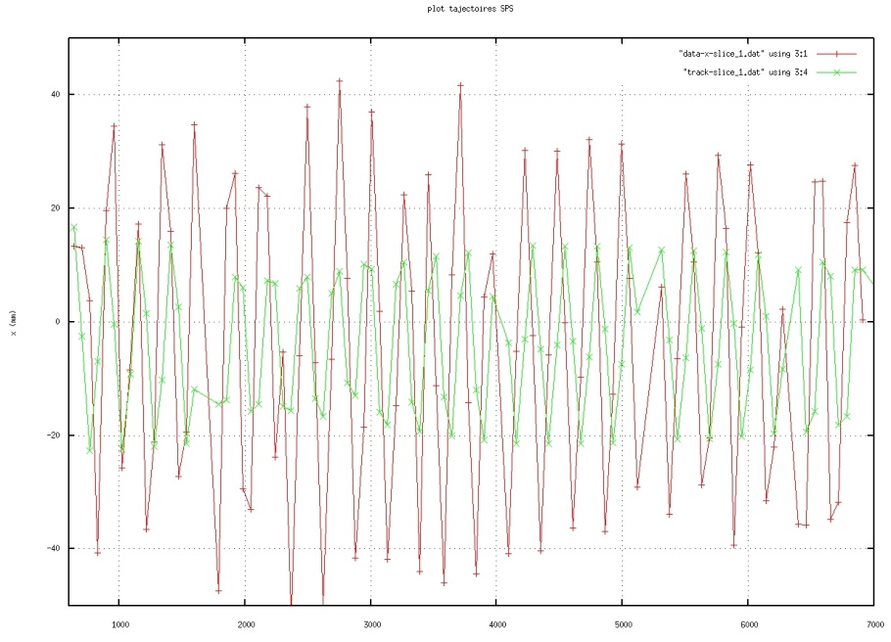
Turn 3, 4 and core : ….

Slide 5
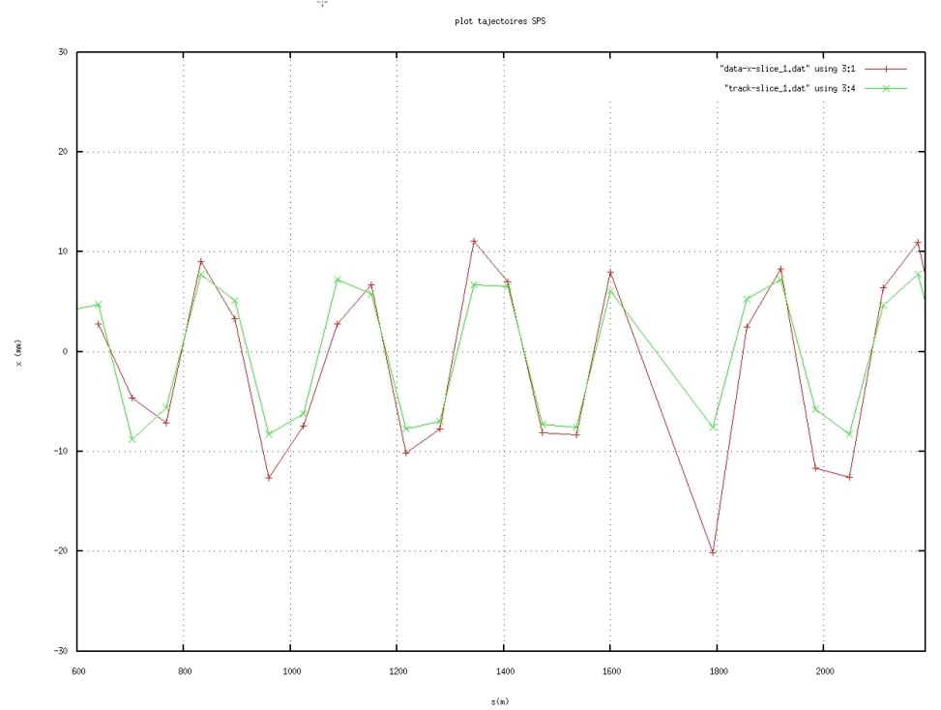
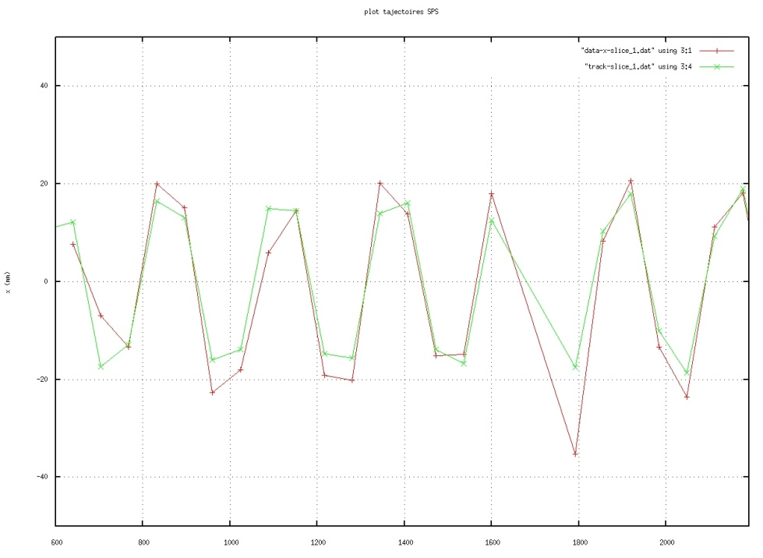
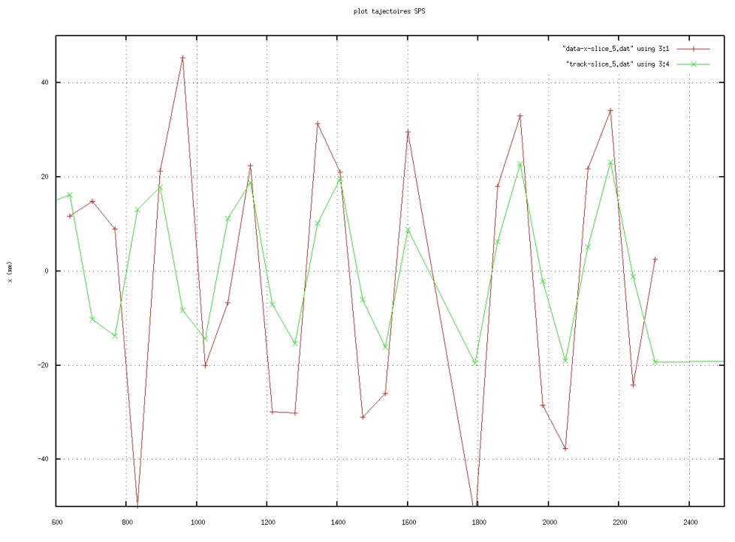
New simulations with low number of BPM for turn 3,4 and 5 :

Slide 6
Extraction position distributions
Turn1
Turn2
Turn3
Turn4

Slide 7
Time dependence of extraction position
Turn1
Turn2
Turn3
Turn4

Slide 8
Extraction slope distributions
Turn1
Turn2
Turn3
Turn4

Slide 9
Time dependence of extraction slope
Turn1
Turn2
Turn3
Turn4

Slide 10
Momentum offset distributions
Turn1
Turn2
Turn3
Turn4

Slide 11
Time dependence of extraction offset
Turn1
Turn2
Turn3
Turn4

Slide 12
Turn2
Extraction parameters correlations

Slide 13
Comparison between D and D’ from measurement and from analysis
Slice Number | Dispersion from measurement (m) | Dispersion from analysis (m)
1 | -5.06 | -10.484 (+107%)
2 | -4.04 | -6.7558 (+67%)
3 | -3.51 | -1.7324 (-50%)
4 | -5.18 | -4.1983 (-20%)
Slice Number | D’ from measurement (m) | D’ from analysis (m)
1 | -0.42 | -0.9532 (+126%)
2 | -0.33 | -0.7847 (+137%)
3 | -0.36 | -0.1574 (-56%)
4 | -0.56 | -0.3137 (-44%)

Slide 14
Turn2

Slide 15
Turn2

Slide 16
Correlation Trapping efficiency / extraction efficiency

