Slide 1
Analysis of recent PS measurements
Last trajectories measures
Kicker stability
Next steps

Slide 2
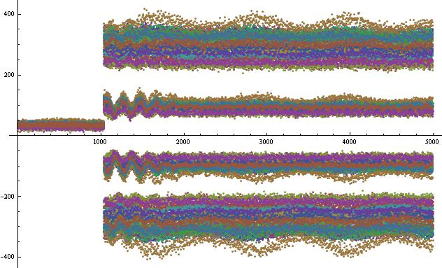
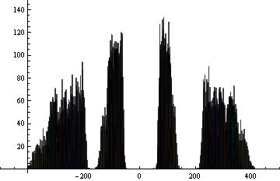
 | Island 1 |  | Island 2 |  | Island 3 |  | Island 4
Pickup 80 | Average | S.deviation | Average | S.deviation | Average | S.deviation | Average | S.deviation
Nominal | -22.41 | 2.467 | -7.351 | 1.069 | 6.367 | 0.636 | 23.851 | 2.199
F8L | -19.376 | 3.266 | -6.231 | 1.425 | 6.094 | 0.779 | 21.167 | 2.751
F8L-noOMT | -27.748 | 4.032 | -9.482 | 1.667 | 9.305 | 1.302 | 29.688 | 3.729

Slide 3
 | SLICE 1 |  | SLICE 2 |  | SLICE 3 |  | SLICE 4
Pickup 80 | Average | S.deviation | Average | S.deviation | Average | S.deviation | Average | S.deviation
Nominal | -22.41 | 2.467 | -7.351 | 1.069 | 6.367 | 0.636 | 23.851 | 2.199
Xmt39 0A Xmt55180A | -22.013 | 1.058 | -6.905 | 0.529 | 7.165 | 0.344 | 24.405 | 0.959
Xmt39130A Xmt5570A | -25.171 | 0.938 | -8.834 | 0.481 | 6.977 | 0.338 | 26.42 | 0.854
 | SLICE 1 |  | SLICE 2 |  | SLICE 3 |  | SLICE 4
Pickup80 | Average | S.deviation | Average | S.deviation | Average | S.deviation | Average | S.deviation
PFW 4 courants | -33.627 | 3.165 | -13.005 | 2.528 | 9.722 | 2.140 | 33.796 | 2.880
PFW 3 courants | -35.670 | 1.8724 | -14.264 | 1.268 | 7.603 | 0.659 | 34.866 | 1.639

Slide 4
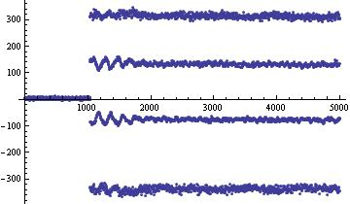
Average position of each island as a function of time
 | SLICE 1 | SLICE 2 | SLICE 3 | SLICE 4
Pickup80 | Spread | Spread | Spread | Spread
F8L | 12.377 | 5.338 | 2.615 | 10.162
F8L - noOMT | 11.440 | 4.761 | 3.626 | 10.962
 | SLICE 1 | SLICE 2 | SLICE 3 | SLICE 4
Pickup 80 | Spread | Spread | Spread | Spread
Nominal | 9.475 | 3.958 | 2.239 | 8.668
Xmt39 0A Xmt55180A | 3.474 | 1.457 | 0.712 | 3.060
Xmt39130A Xmt5570A | 2.680 | 1.157 | 0.811 | 2.804
 | SLICE 1 | SLICE 2 | SLICE 3 | SLICE 4
Pickup80 | Spread | Spread | Spread | Spread
PFW 4 courants | 8.945 | 4.891 | 3.008 | 8.504
PFW 3 courants | 5.110 | 3.514 | 1.498 | 4.391

Slide 5
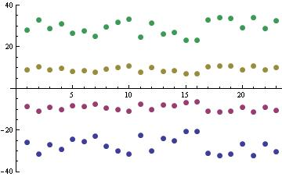
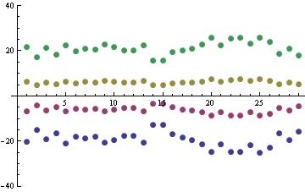
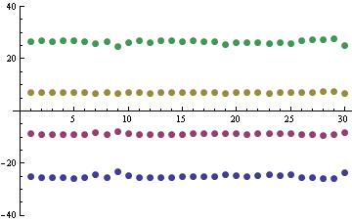
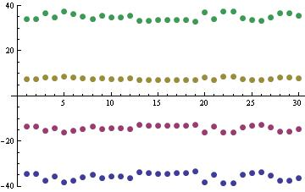
Average position of island (F8L for tune control -noOMT)
Average position of island (F8L for tune control)
Average position of island (XMT.39130A-XMT5570A)
Average position of island (PFW 3 currents)

Slide 6
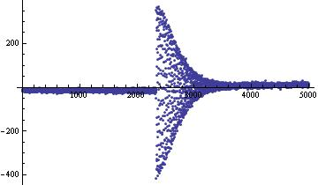
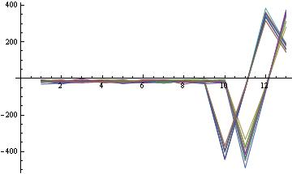
Kicker stability

Slide 7
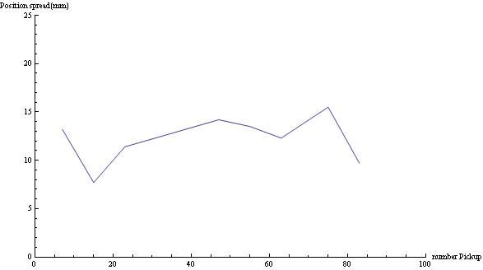
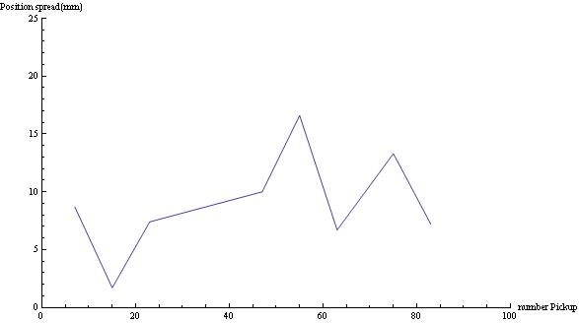
Kicker spread along the PS (tune control with F8L)
Average spread : 12.1 mm
Same measure with F8L – 4A
Average spread 9 mm

Slide 8
Next steps :
Analysis of analogic signal from kicker
Phase space reconstruction and FFT analysis
decoherence study

