Slide 1
MTE latest measurements
A.Lachaize MTE meeting 25/08/11

Slide 2
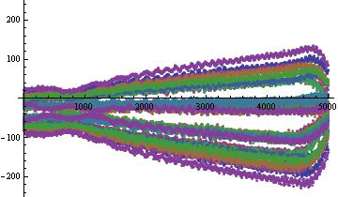
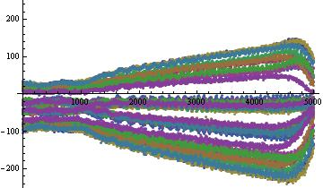
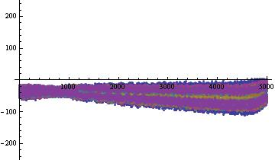
Island’s orbits have been measured during the tune ramp used to move the island far away from the core after capture.
First measurements August, 14th
After a EASTB cycle
After a ZERO cycle
After a TOF cycle

Slide 3
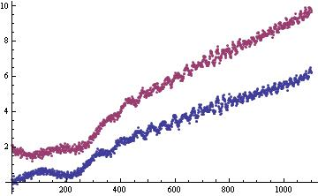
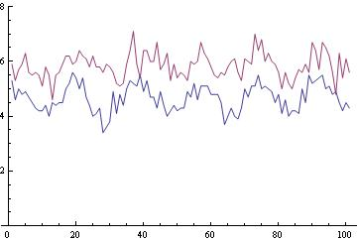
ZERO
mm
mm
ZERO
EASTB
EASTB
Average position of the top island
Spread of the beam at the top of the tune ramp (peak to peak)
Average position of the beam before tune ramp | EASTB | ZERO
 | -3.41 mm | -3.35 mm
Average position of the top island before ramp | EASTB | ZERO
 | 0.41 mm | 1.71 mm
Average position of the top island after ramp | EASTB | ZERO
 | 6.5 mm | 10 mm

Slide 4
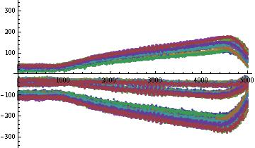
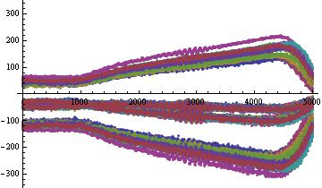
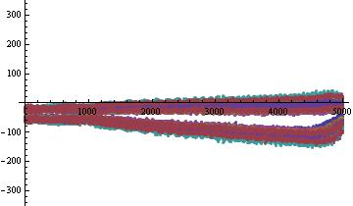
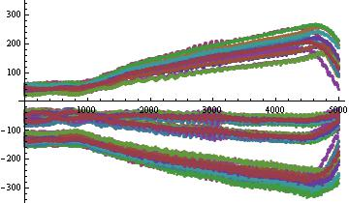
New measurements, last week
After a EASTB cycle
After a ZERO cycle
After a TOF cycle, during the afternoon….
After a TOF cycle, during the morning

Slide 5
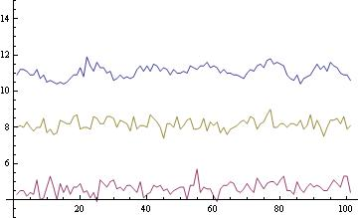
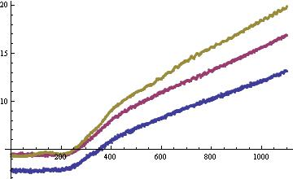
mm
mm
TOF
ZERO
TOF
EASTB
ZERO
EASTB
Average position of the top island
Spread of the beam at the top of the tune ramp (peak to peak)
Average position of the beam before tune ramp | EASTB | ZERO | TOF
 | -3.67 mm | -3.74 mm | -4.69 mm
EASTB | ZERO
-3.41 mm | -3.35 mm
Average position of the top island before ramp | EASTB | ZERO | TOF
 | 2.79 mm | 4.44 mm | 4.44mm
EASTB | ZERO
0.41 mm | 1.71 mm
Average position of the top island after ramp | EASTB | ZERO | TOF
 | 13.25 mm | 19.88 mm | 16.91 mm
EASTB | ZERO
6.5 mm | 10 mm

Slide 6
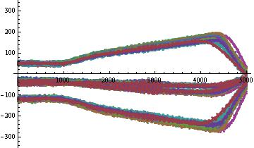
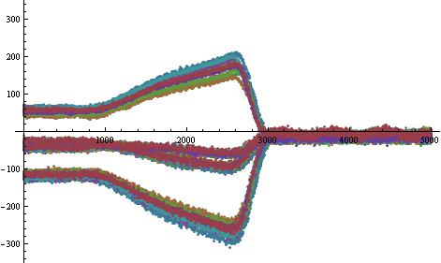
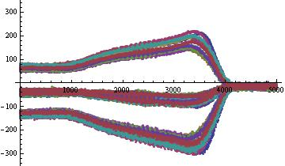
Measurements with various configurations (all after a EASTB)
Tune ramp shifted by 5ms
2 times faster tune ramp
Tune ramp with octupoles on

Slide 7
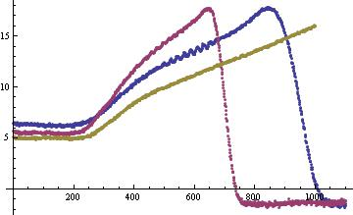
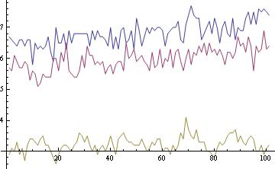
mm
5ms ramp
Octupoles
mm
Octupoles
shifted
5ms ramp
shifted
Average position of the top island
Spread of the beam at the top of the tune ramp (peak to peak)
Average position of the beam before tune ramp | Octupoles | 5ms ramp | Shifted
 | -3.73 mm | -3.30 mm | -3.63 mm
EASTB
-3.67 mm
Average position of the top island before ramp | Octupoles | 5ms ramp | Shifted
 | 6.27 mm | 5.47 mm | 4.98 mm
EASTB
2.79 mm
Average position of the top island after ramp | Octupoles | 5ms ramp | Shifted
 | 17.82 mm | 17.75 mm | 16.08 mm
EASTB
13.25 mm

Slide 8
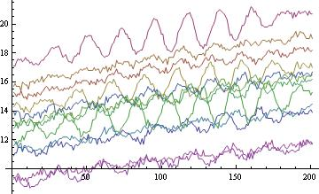
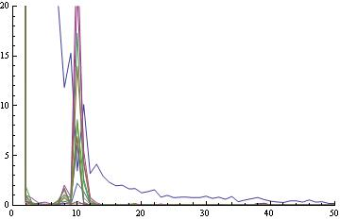
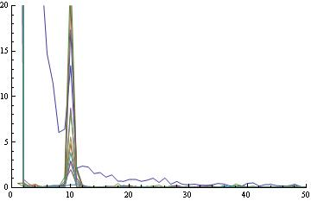
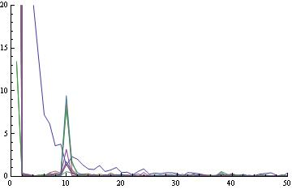
Observed fluctuations for basic measurements
Fluctuations for TOF cycle
EASTB
TOF
ZERO

Slide 9
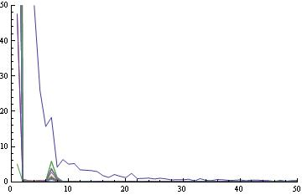
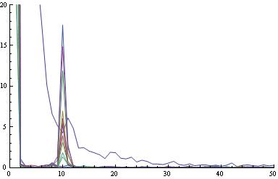
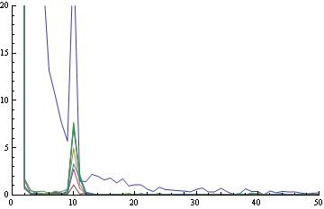
Observed fluctuations for measurements with various configurations
5ms ramp
shifted ramp
Octupoles on

Slide 10
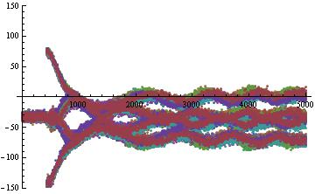
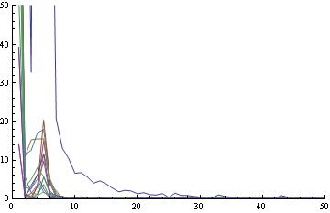
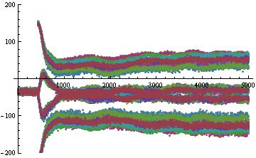
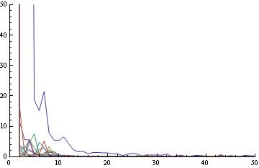
Does it correspond to a recoherence ?

