Slide 1
Vacuum Analysis of PS Sector 20
C. Pasquino, P. Chiggiato, J. Hansen, P. R. Demarest

Slide 2
outline
PS sector 20 : vacuum layout
Electrical Network – Vacuum analogy: principles
Vacuum simulations & results
Conclusions & accomplishments
Acknowledgements

Slide 3
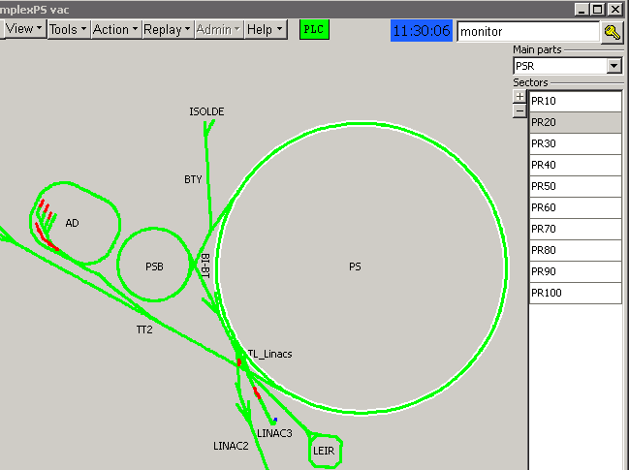
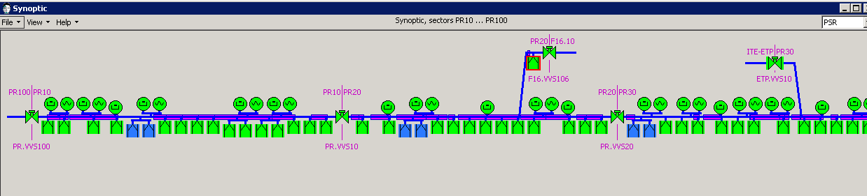
PS sector 20 vacuum layout
16 Sputter Ion Pumps (SIP) 220 l/s;
5 Penning gauges : VGP13, VGP13a, VGP16, VGP17, VGP18.
Goal: to evaluate how the installation of the dummy 15 is going to affect the pressure profile in the PS ring

Slide 4
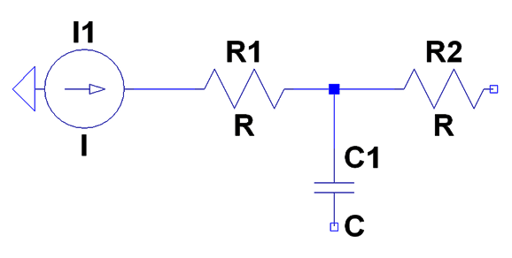
Electrical Network – Vacuum Analogy: principles
VACUUM | ELECTRICAL NETWORK
Volume | Capacitance
Conductance | Resistance
Flow | Current
Pressure | Voltage
Qin

Slide 5
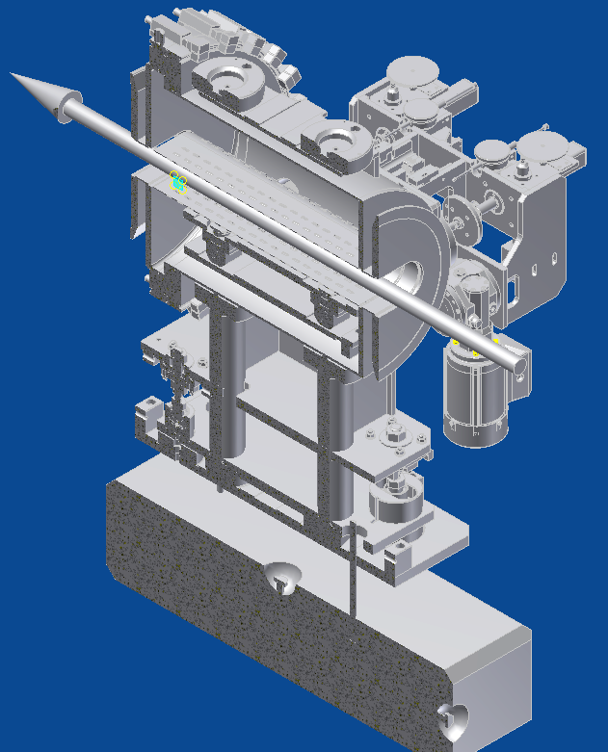
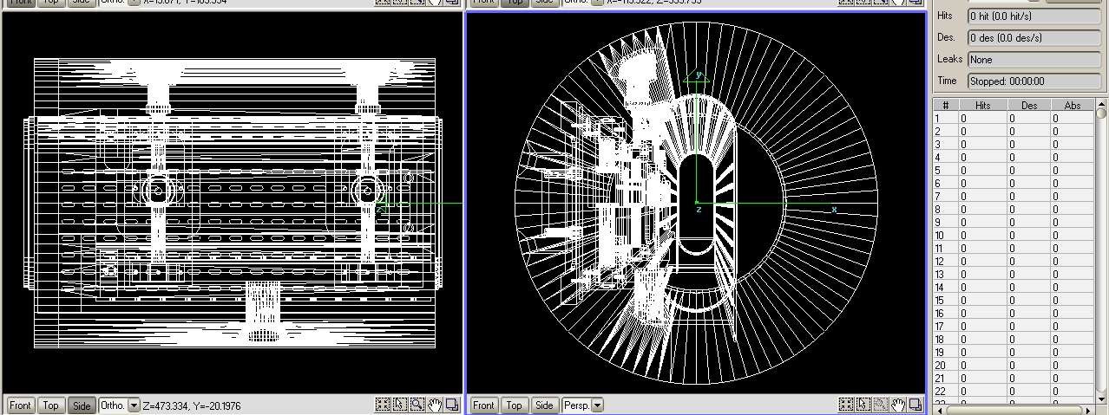
Electrical Network – Vacuum Analogy:dummy15 conductance calculation
MOLFLOW*
T temperature;
R gas constant;
M_{m} molecular mass;
Area of the entrance;
α transmission probability;
*program written by R. Kersevan

Slide 6
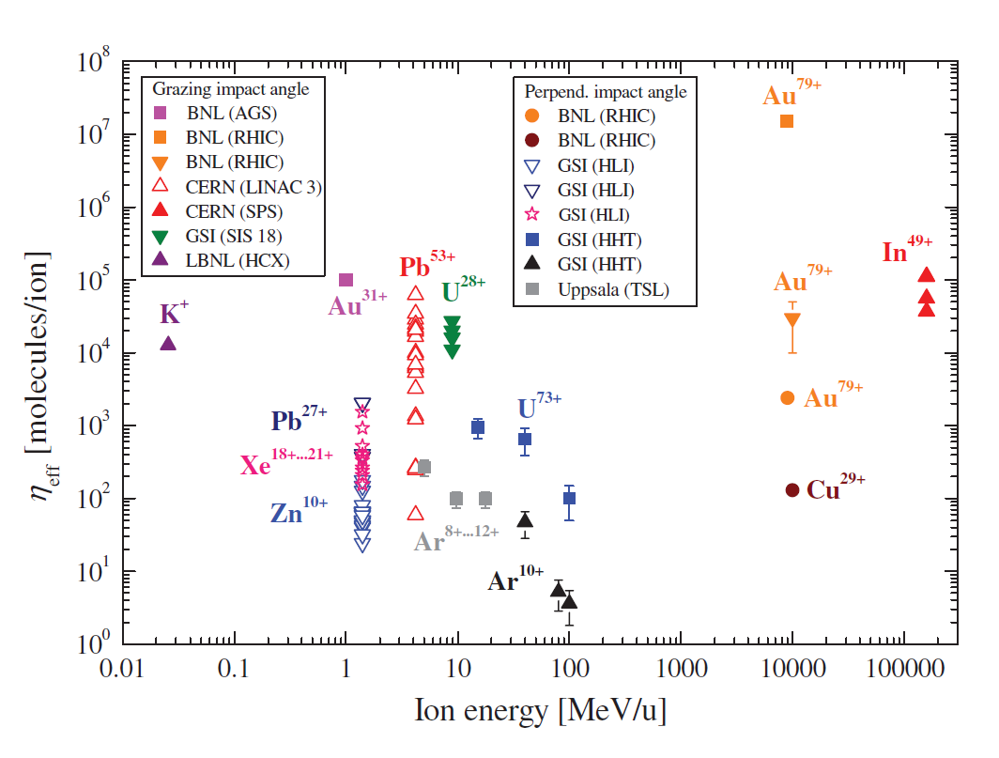
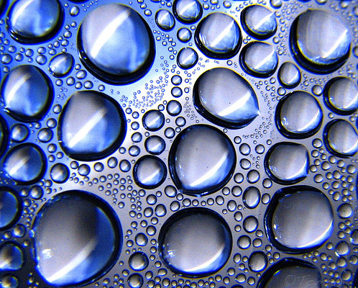
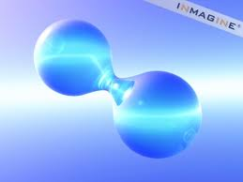
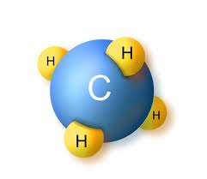

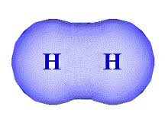
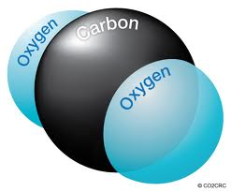

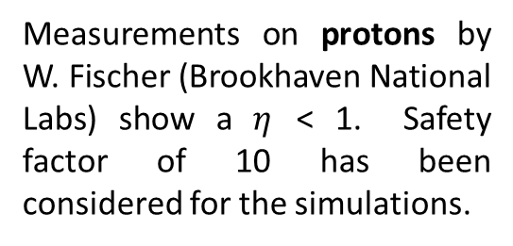
Electrical Network – Vacuum Analogy: outgassing data
E. Mahner, PRST
The desorption yield $η$ depends on:
the nature of the ion;
Its energy;
Its angle of impingment;
Temperature of the substrate;
Dose (cleaning effect).
Measurements on protons by W. Fischer (Brookhaven National Labs) show a $η$ < 1. Safety factor of 10 has been considered for the simulations.
Non baked vacuum line: water vapor outgassing
Hydrogen outgassing (200-300 h of pumpdown)
Beam losses: Ion Induced Desorption H₂, CO, CO₂,CH₄

Slide 7
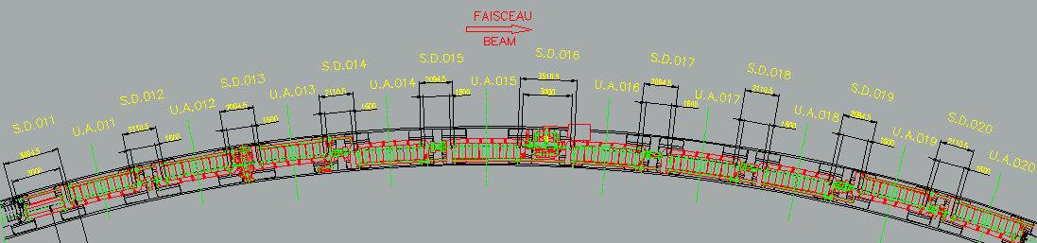
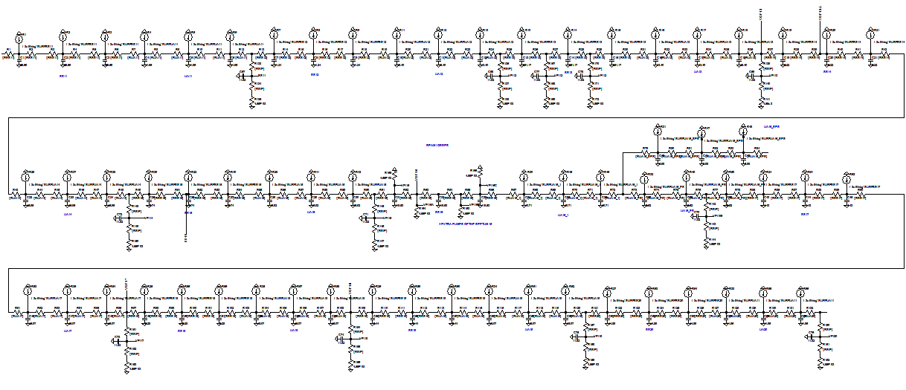
Equivalent Electrical Network – sector 20

Slide 8
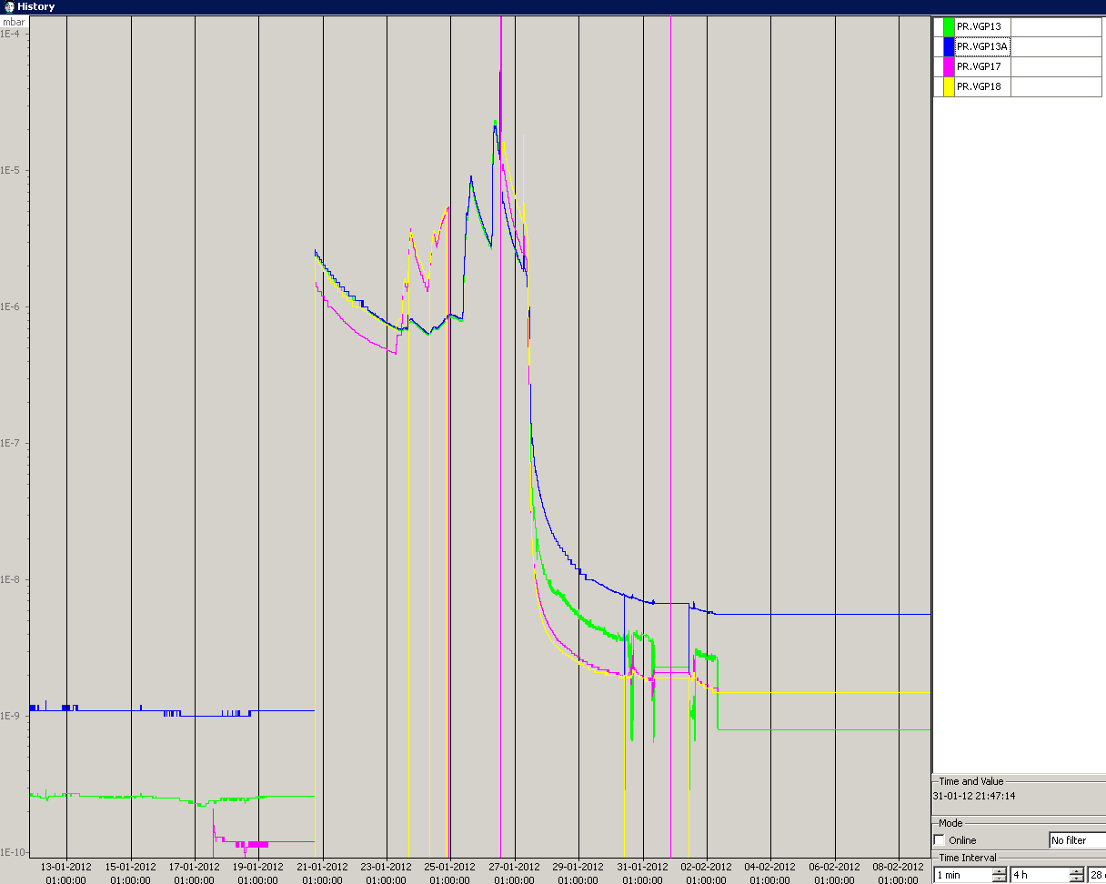
PS sector 20 simulations: present situation
Case Study: intervention on Septum 16, January 2012
12 days
H₂O + H₂
1*10⁻⁹ mbar
No beam losses induced total pressure rise

Slide 9
PS sector 20 simulations: INSTALLATION OF DUMMY 15
No beam losses induced total pressure rise

Slide 10
DUMMY 15 INSTALLATION: ACTIONS AND CONCLUSIONS
The simulations shows that the installation of dummy 15 is not going to have a major impact on PS sector 20 pressures profiles;
The installation of extra pumping group is not needed: the current vacuum system is going to cope with the gas loads coming from the dummy 15;
Contingency: installation of a blind flange in case of future need.
Acknowledgements: M. Hourican, J.-M. Lacroix, S. Damjanovic, S. Gilardoni.

